Slide 1
GENERATIVE AI
Presented By:
SURIYA S
513121104042
THANTHAI PERIYAR GOVERNMENT INSTITUTE
OF TECHNOLOGY VELLORE

Slide 2
PROJECT TITLE
TEXT TO MUSIC GENERATOR

Slide 3


AGENDA
Problem Statement
Project overview
End Users
Solution and its proposition
The WOW in the solution
Modeling
Results
Conclusion
3/21/2024 Annual Review

Slide 4

PROBLEM STATEMENT
Develop a text-to-music generator capable of converting written text into musical compositions, enabling users to create dynamic soundtracks that reflect the sentiment and content of the provided text

Slide 5

PROJECT OVERVIEW
Developing a Text-to-Music Generator to convert written text into musical compositions. The system will analyze text for mood and tone, generate melodies accordingly, and provide a user-friendly interface for customization. Output options will include MIDI and audio formats. Targeting music enthusiasts, content creators, educators, and developers, the project aims to enhance creativity and accessibility in music. The development timeline spans around 7-9 months, with a budget allocated for personnel, technology, licensing, and marketing.

Slide 6

WHO ARE THE END USERS?
Music Enthusiasts: Individuals passionate about music who want to explore new ways of musical expression and creativity.
Content Creators: Writers, poets, and storytellers seeking to transform their textual works into musical compositions for artistic expression or multimedia projects.
Educators: Music teachers and students interested in using innovative tools for teaching and learning music theory, composition, and creative writing.
Developers: Researchers and developers exploring the intersection of artificial intelligence, natural language processing, and music generation, potentially for academic research or commercial applications.

Slide 7

YOUR SOLUTION AND ITS VALUE PROPOSITION
Our text-to-music generator offers:
Creativity Amplification: It transforms written words into unique musical expressions, fostering artistic exploration for songwriters and poets alike.
Accessibility: With a user-friendly interface, it democratizes music composition, making it accessible to everyone regardless of musical background or technical expertise.
Personalization: Tailoring musical output to desired emotions is easy with customizable options like tempo, instrumentation, and genre preferences, enhancing creative control.
Efficiency: By automating the conversion process, it streamlines workflow, saving time and effort for both professionals and amateurs.
Inspiration and Collaboration: It acts as a catalyst for collaboration, facilitating idea exchange among creators and providing a platform where artistic visions can thrive.

Slide 8

THE WOW IN YOUR SOLUTION
Deep Understanding of Text and Music: Utilizing cutting-edge NLP algorithms, it ensures precise capture of mood, tone, and rhythm from input text.
State-of-the-Art Music Generation: Powered by advanced ML models, it produces compositions rivaling human composers, pushing the boundaries of automated music generation.
Intuitive User Experience: Prioritizing user experience, it offers a sleek interface for effortless conversion, catering to creators of all levels.
Unparalleled Customization: With extensive options for tempo, instrumentation, and genre, users can tailor compositions to their exact specifications, ensuring uniqueness.
Community and Collaboration: Fostering a vibrant creator community, it provides avenues for collaboration, feedback, and inspiration, enabling artistic visions to thrive.
3/21/2024 Annual Review
8

Slide 9
MODELLING
Natural Language Processing (NLP):
Tokenization and Embeddings: Convert input text into numerical representations using techniques like Word2Vec or GloVe to capture semantic meaning efficiently.
Language Models: Utilize pre-trained language models such as GPT to grasp the context and semantics of the text comprehensively.
Music Generation Models:
Sequence-to-Sequence Models: Utilizing RNNs, LSTMs, or Transformers to create music sequences from text, ensuring coherence.
Conditional Generative Models: Employing CVAEs or cGANs to generate personalized music based on input text, enhancing relevance.
Symbolic Music Generation: Representing music in MIDI format and training models for coherent musical sequences.
Audio-based Models: Converting text to audio representations (e.g., spectrograms) and using models like WaveNet or SampleRNN to generate high-quality audio directly
9

Slide 10
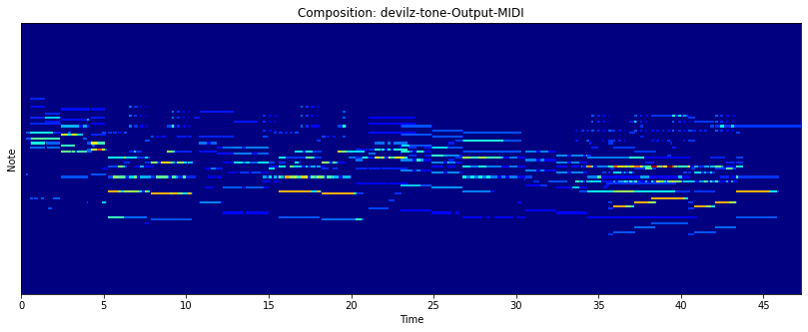
RESULTS
10

Slide 11


